Slide 1
Automated Testing Stratgey
Overview

Slide 2
Preparation
Install PHP
Install apache MAVEN2
Install Selenium IDE add on for firefox
Install Selenium PHP formatter add on for firefox as needed
Open a Sauce Labs account and login
Create a SaurceLab Folder on your computer
Run Maven to sync a SaurceLab base template project to the folder you just created
In window, go to file tab, open in command prompt, run the maven command from your saucelab account: https://saucelabs.com/docs/ondemand/getting-started/env/java/se2/windows (remove backslash &newlines characters)

Slide 3
Main Objectives
Run Firefox Selenium Ide to record the testing into a test script
Save the test script in junit4 webdriver backed format
Run test script for netbean to access Saurce lab's virtual machines (Different OS platform on different browser)
View and save result of the test

Slide 4
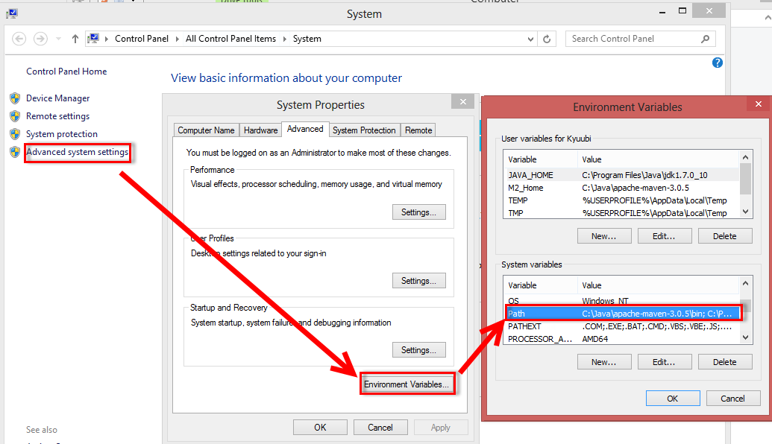
Install Maven

Slide 5
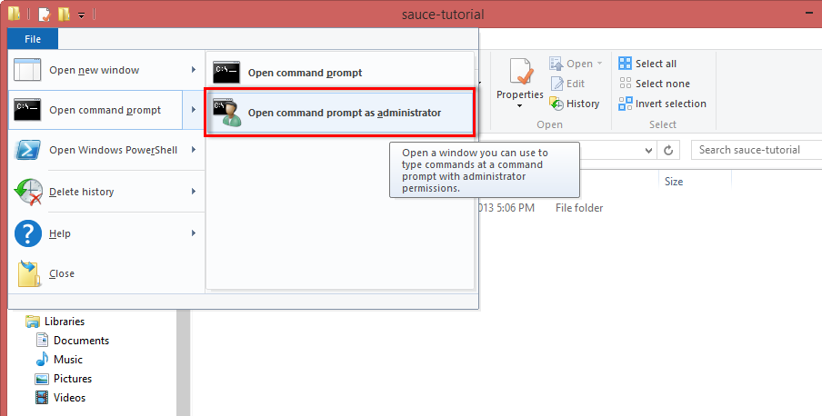
Create local project folder

Slide 6
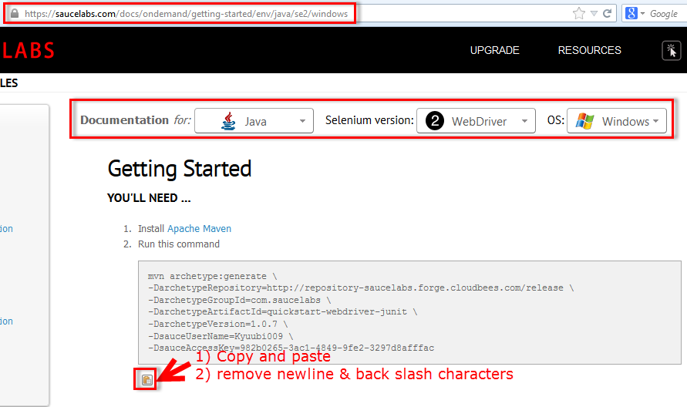
Get your Saurcelabs Maven Project

Slide 7
Run command
mvn archetype:generate
-DarchetypeRepository=http://repository-saucelabs.forge.cloudbees.com/release
-DarchetypeGroupId=com.saucelabs -DarchetypeArtifactId=quickstart-webdriver-junit
-DarchetypeVersion=1.0.7
-DsauceUserName=Henry009 -DsauceAccessKey=12312323123123123

Slide 8
Record test script with Selenium IDE

Slide 9
Selenium IDE

Slide 10
Run Selenium test script as Junit test from Eclipse
Demo Code: https://github.com/9tails/JavaSelenium/
Selenium test scripts could be written in JAVA or PHPunit or other languages

Slide 11
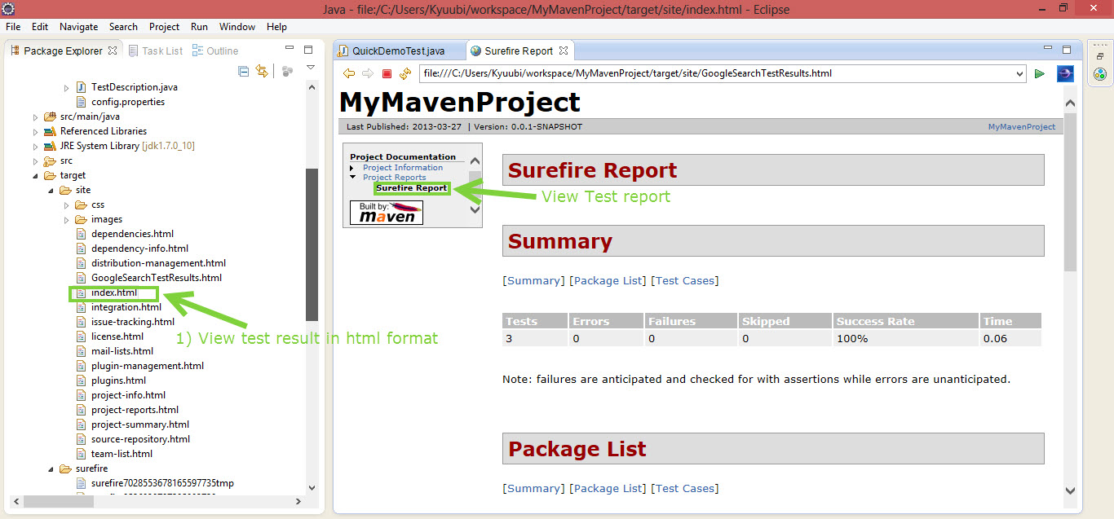
View test result from Eclipse

Slide 12
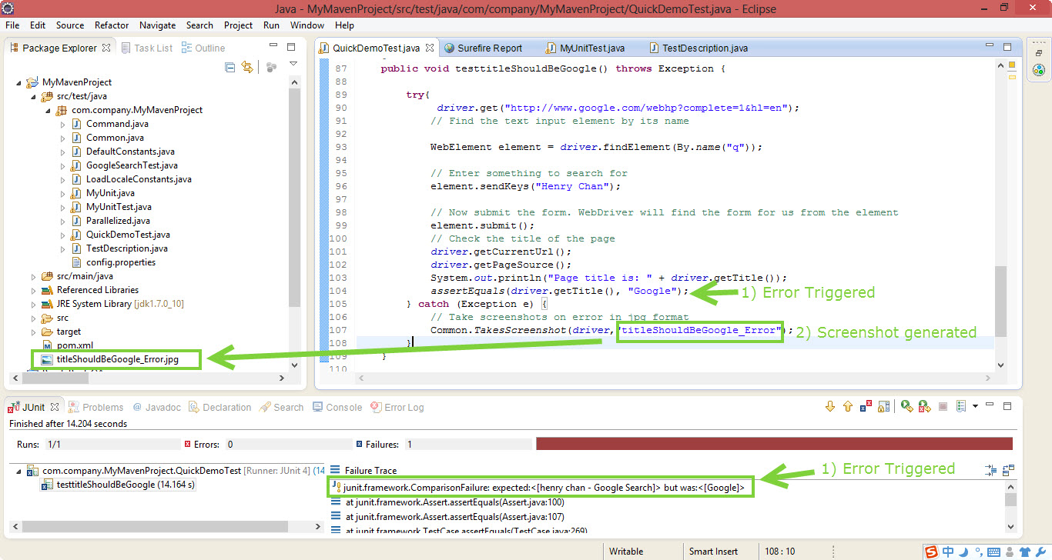
Creating a screenshot on error

Slide 13
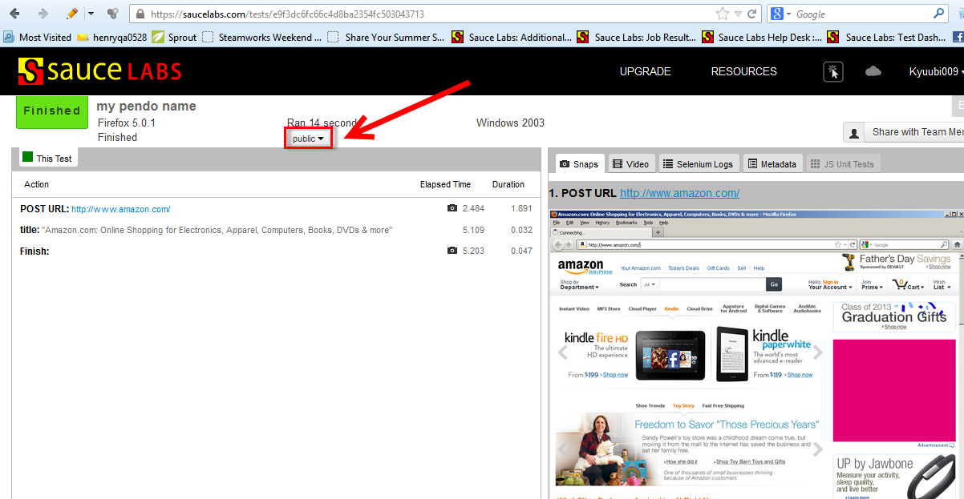
View Test Result from Saurce Labs

